Slide 1
RNA Probe Design & QC Pipeline
16 NOV 2020

Slide 2
RNA Fusion - Probe Design
Initially provided to IDT:
308 fusions detected either from DNA or from RNA
Initially requested to IDT:
Probes to be designed on RNA
And following this protocol:
120 + 0
90 + 30
60 + 60
30 + 90
0 + 120
5’ GENE
3’ GENE
BREAKPOINTS

Slide 3
RNA Fusion - Probe Design
Initially provided to IDT:
308 fusions detected either from DNA or from RNA
Initially requested to IDT:
Probes to be designed on RNA 17.5% probes designed in introns
And following this protocol: Protocol misunderstood:
120 + 0
120 + 0
90 + 30
120 + 0
60 + 60
60 + 60
30 + 90
0 + 120
0 + 120
0 + 120
5’ GENE
3’ GENE
5’ GENE
3’ GENE
BREAKPOINTS
- Large amounts of WT / DNA / pre-mRNA
- Some fusions with no data to work with

Slide 4
RNA Fusion - Probe Design
From DNA:
Exact positions can be detected
Very high number of possibilities
No evidence of expression
Independent from gene isoforms
From RNA:
Exact positions often not known
Lower number of possibilities
Clear evidence of expression
Dependent on gene isoforms
BRK
BRK
E1
E2
E3
E1
E2
E3
5’ ISOF 1
5’ ISOF 1
E1
E2
E3
E1
E2
E3
5’ ISOF 2
5’ ISOF 2
E1
E2
E1
E2
5’ ISOF 3
5’ ISOF 3
TARGET REGION

Slide 5
RNA Fusion - Probe Design
Using RefSeq & Ensembl:
~200 possible combinations / fusion
Transcript scoring system
Probe position scoring system
All combinations ranked
1 or 2 probe sets extracted / fusion
From RNA:
Exact positions often not known
Lower number of possibilities
Clear evidence of expression
Dependent on gene isoforms
BRK
E1
E2
E3
120 + 0
5’ ISOF 1
90 + 30
60 + 60
E1
E2
E3
30 + 90
5’ ISOF 2
0 + 120
5’ GENE
3’ GENE
E1
E2
5’ ISOF 3
BREAKPOINTS

Slide 6
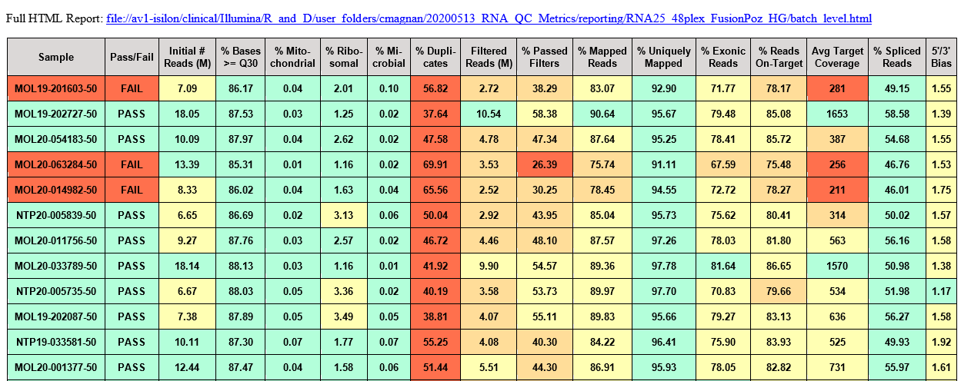
RNA QC Pipeline - Emails

